Slide 1
DU Bootcamp
Group project
Data Analyst Jobs Analysis
a tool for our colleagues
Developed by
The Psycho Data Squad!
Jacquie, Justin, Taylor & Julie
November, 2021

Slide 2

Where will your future take you?

Slide 3
Overview
Amidst the pandemic many people lost their jobs, with this dataset it is possible to hone the job search so that more people in need can find employment.
Purpose
Analyze 2000 job listing for data analyst positions
Provide a machine learning tool for personal use
November, 2021

Slide 4

The process:
Database Work
Machine Learning, draft then final- Design/Prototyping/Finalizing/continuous improvement process, draft, then final
- Takes in the provisional DB & - Outputs labels for input data
Description of the prelim feature engineering, selection, and decision-making process
Machine Learning, description of how dtaa was split into t & t
Machine Learning explanation of model choice, including pros and cons
Database Development with sample Data testing/developing the db structure/schema(s) practice with prototypes
Database Development-including a least 2 tables joined (in Postgres)
Include at lease 1 connection string (using sqlalchemy)
Repository Practice/Teaming- multiple commits for each
Presentation Development
With descriptions of data exploration phase of the project and the analysis phase of the project
#2
Machine Learning Predictions & Interactive Visuals
Presentation Upload all code so far to Git Hub shared repo
Machine Learning, draft then final- Design/Prototyping/Finalizing/continuous improvement process, draft, then final
- Takes in the provisional DB & - Outputs labels for input data
Description of the prelim feature engineering, selection, and decision-making process
Machine Learning, description of any recent changes/improvements
Database enhancements and descriptions
Build an APP using Flask and Mongo DB
Finalize Presentation
Finalize DB
Finalize ML
Finalize APP work
Self-Assessments
Team-Assessments
#3
#4
Data Explore
Topic Selection, Reason
Data Selection & Description
Shared GitHub Repository Set-up, with individually managed branches
#1

Slide 5
Phase #1
Data Exploration
Question we want to answer
Find the best data selection
Database setup
Shared GitHub repository with individual branches setup

Slide 6


Initial Data Analysis
Basic Measures/info
Analysis

Slide 7
The Data Sets
Project Overview:
For this project we are analyzing datasets created by picklesueat from Kaggle
Description of the Source Data:
One dataset contains job openings advertisements for Data Analyst Jobs - from 1 year ago - approx 2253 records total. The second dataset needed will be Longitudes and Latitudes - a way to map some results on a map, interactively.
An additional dataset, called datajobs_geo was needed for ML model so it was joined to collect latitude and longitude info
Jacquie, also developed a dataset to use for the Leaflet Interactive Map of “Average Salary by State”
Analysis

Slide 8
Analysis
Questions we hope to answer.
In this analysis I will be focusing on the following questions:
- � What is the Minimum Salary?
- � What is the Maximum Salary?
- � What is the Average Salary?
- � What are the number of Job Openings by Job Title?
- � What are the number of Job Openings by Industry?
- � What are the number of Job Openings by Sector?
- � Do companies with higher ratings pay higher salaries?
- � Do companies with lower ratings pay lower salaries?

Slide 9
Attribute Information:
- Job Title
- Rating
- Company Name
- Industry
- Sector
- Salary Minimum - added this column
- Salary Maximum - added this column
- Salary Average - added this column
- ADDED Salary Low Bottom of Range
- ADDED Salary Med Middle of Range
- ADDED Salary High Top of Range
- ADDED Salary Level
Considerations we could extract:
- Python Jobs
- SQL Jobs
- Excel Jobs
- Tableau jobs
Analysis

Slide 10
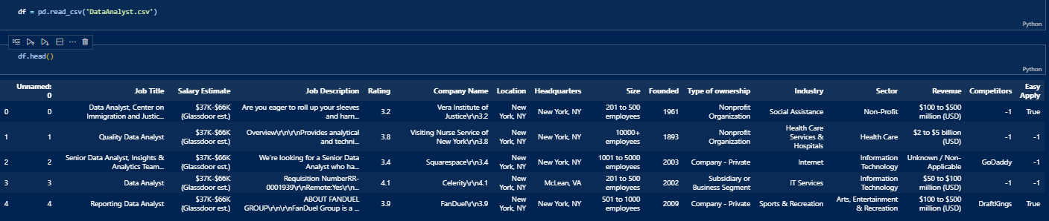
The Data Analysis Story
Analysis/ETL
We begin with 1 of the original datasets - We have a lot of information!
What specific data do we really need to begin analysis?
Salary metrics and A categorical “easy-apply” value y/n
We begin the work to Extract, Transform, and Load (ETL)
Click here for the Code

Slide 11
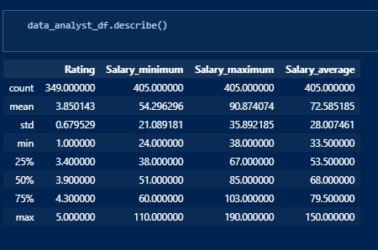
Develop New DataFrames with Pandas
Analysis/ETL
Developed a Min, Max, and Avg to work with in
future charts and visualizations

Slide 12
Develop Visuals with Plotly
Analysis/ETL
Developed a Min, Max, and Avg to work with in future charts and visualizations

Slide 13
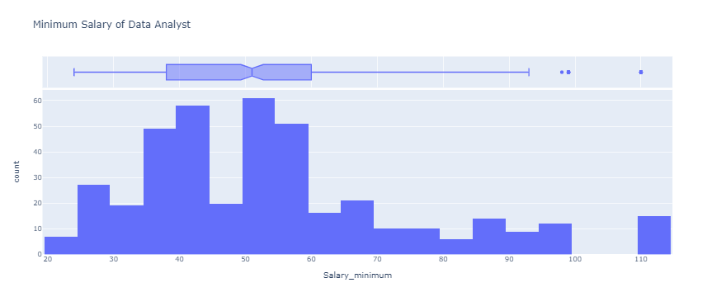
� What is the Minimum Salary?
Analysis/Visualization
With Python and Matplotlib we can plot a histograms in one line of code, and observe the frequency of distribution for various features. We can read frequency on y-axis and feature values on the x-axis. We can easily plot histograms for the entire dataset, for all features as well as individual features to get a more detailed look.

Slide 14
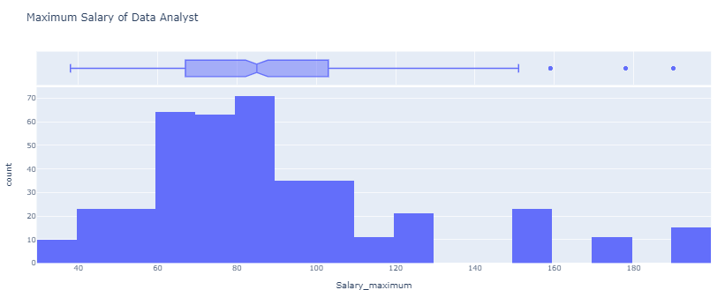
� What is the Maximum Salary?
Analysis/Visualization

Slide 15
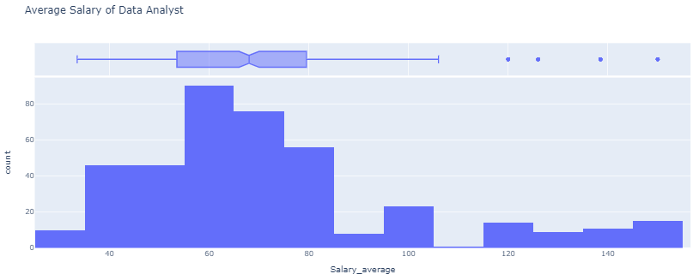
� What is the Average Salary?
Analysis/Visualization

Slide 16
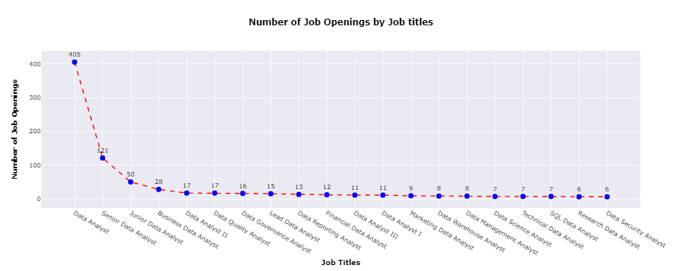
� What are the number of Job Openings by Job Title?
Analysis/Visualization

Slide 17
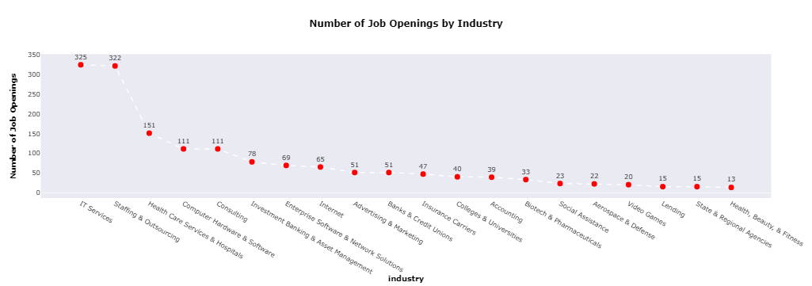
� What are the number of Job Openings by Job Title by Industry?
Analysis/Visualization

Slide 18
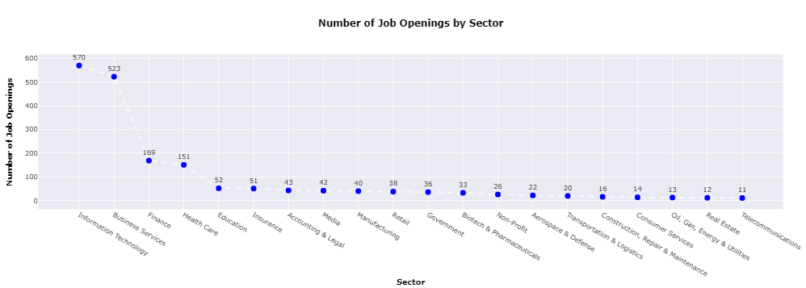
� What are the number of Job Openings by Job Title by Sector?
Analysis/Visualization

Slide 19
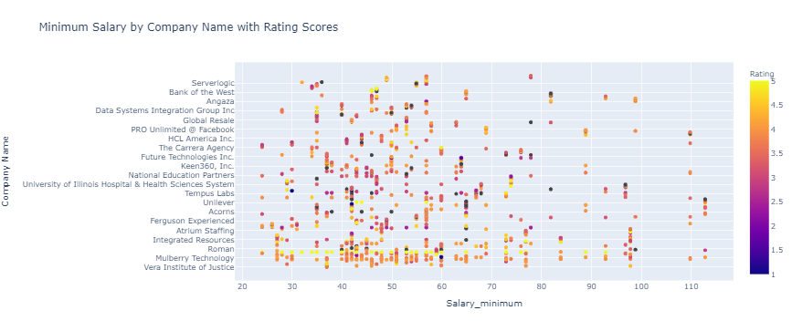
� Minimum Salary by Company Name with Rating Scores?
Analysis/Visualization
Distributions and Correlations - looking for patterns & relationships

Slide 20
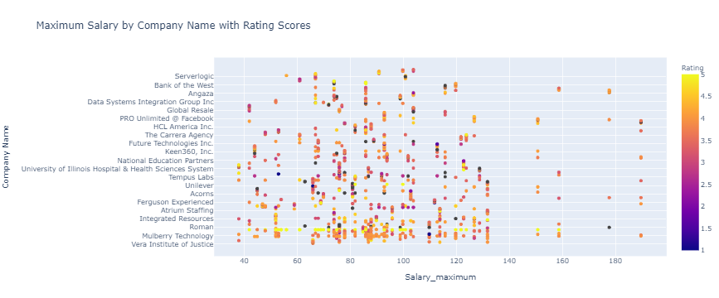
� Maximum Salary by Company Name with Rating Scores?
Analysis/Visualization
Distributions and Correlations - looking for patterns & relationships

Slide 21
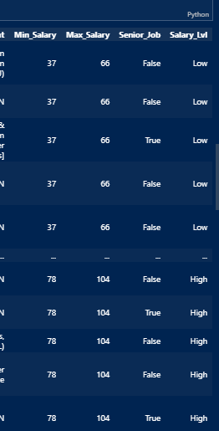
Deep Dive on the Data Cleaning & Transformation
Developed multiple data frames to continue to
extract needed key information into the correct format
Deeper Dive into the Data
Added A Senior Job column - T/F
Added Salary Level - Low, Med, High based on the Salary Ranges
We didn’t use so far, keep? yes/no??
Click here for the Code

Slide 22
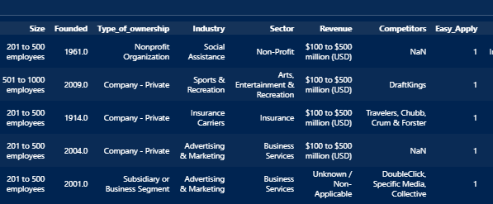
Deep Dive on the Data Cleaning & Transformation
Developed multiple data frames to continue to
extract needed key information into the correct format
Deeper Dive into the Data
Recoded 3 columns
Size,
Revenue,
& Easy Apply

Slide 23
Phase #2
Database Prep for ML and Visuals

Slide 24
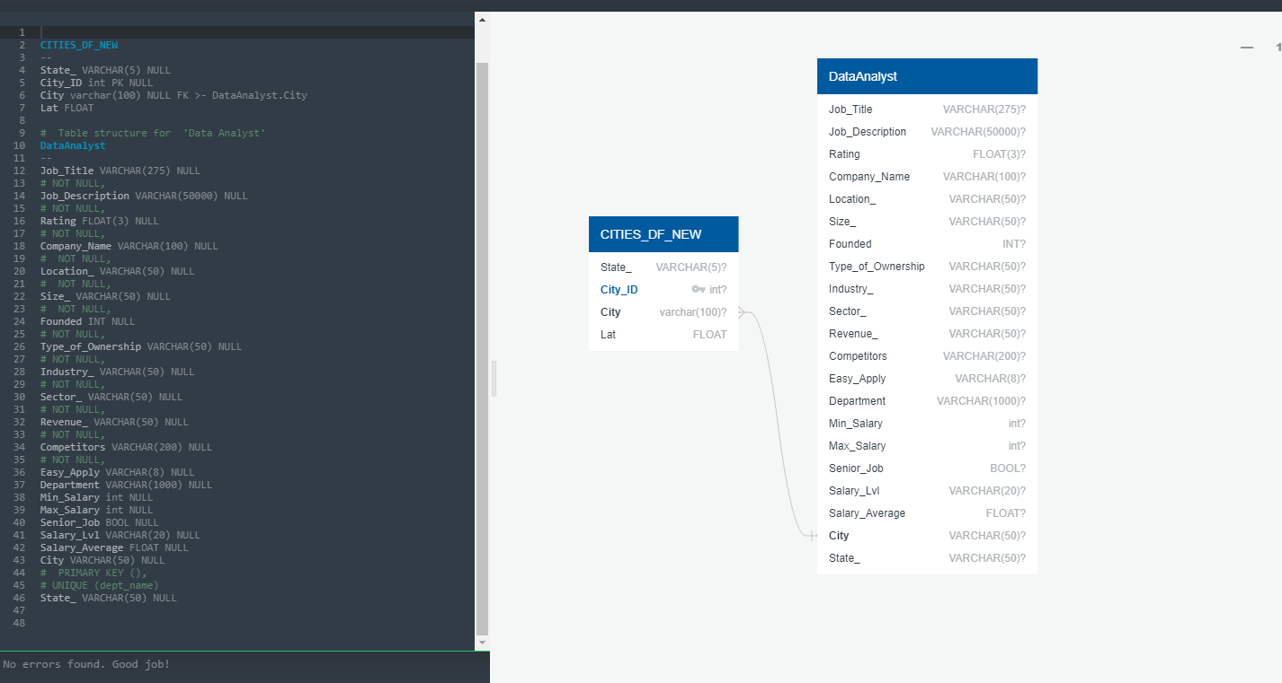
Database work THE ERD - Entity Relationship Diagram

Slide 25
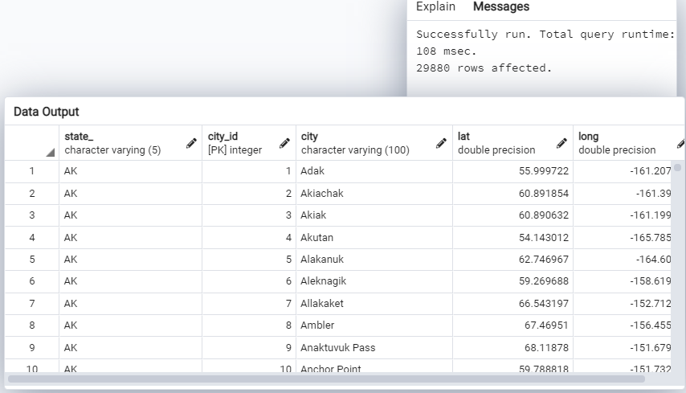
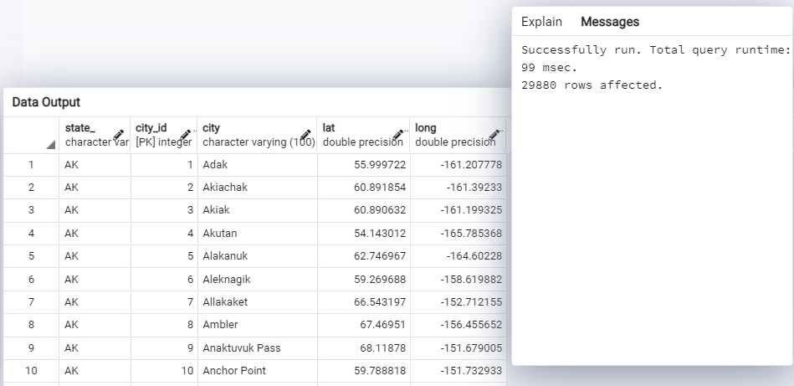
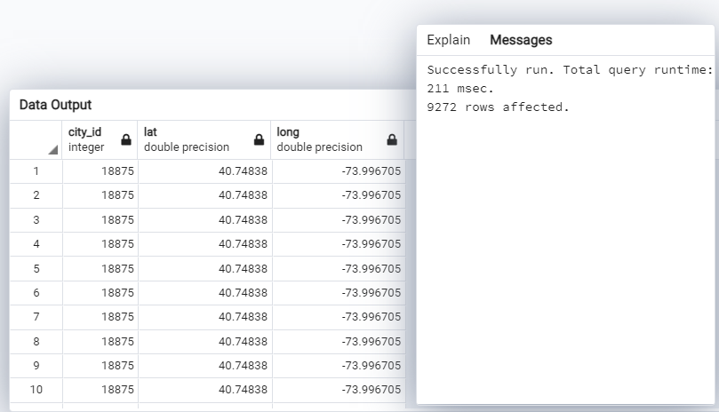
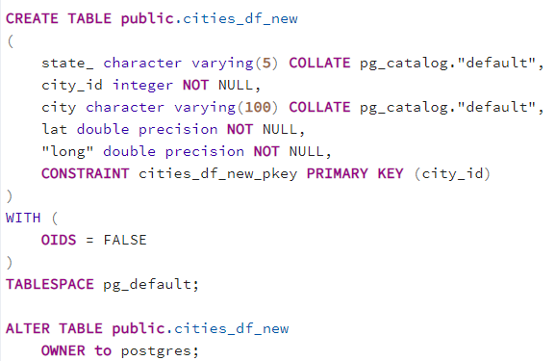
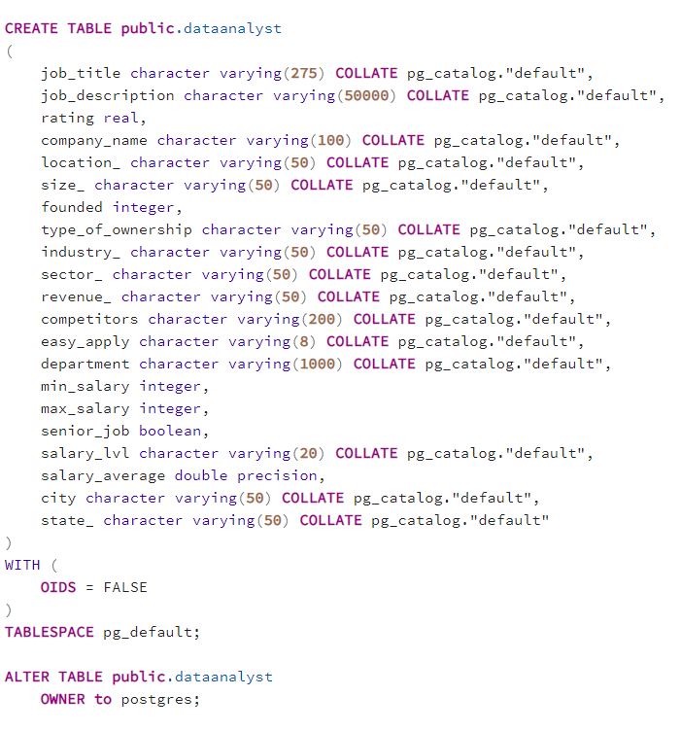
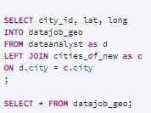
Database work -A join using Database Language SQL

Slide 26
Phase #3
Machine Learning -1 PCA K-means
Predicting the classes
Find relation between Company Rating,Means Salary and Years Founded

Slide 27
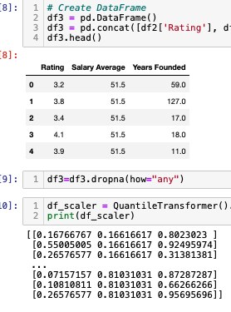
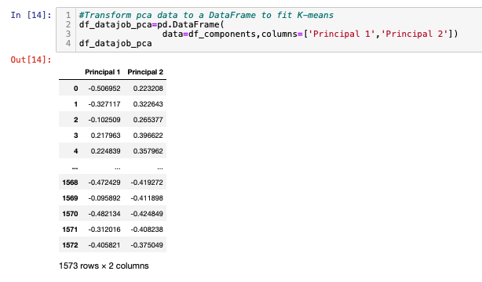
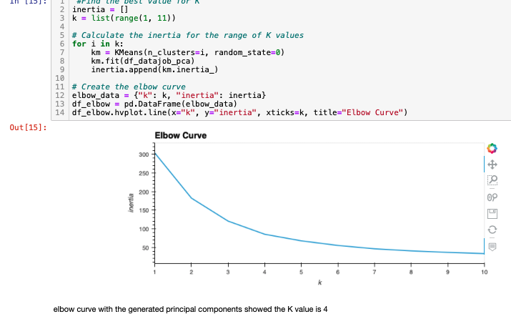
Machine Learning
PCA K-means
Scale the Datasets
Transform
Find the K means

Slide 28
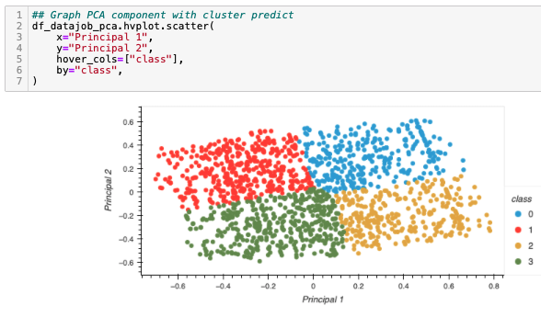
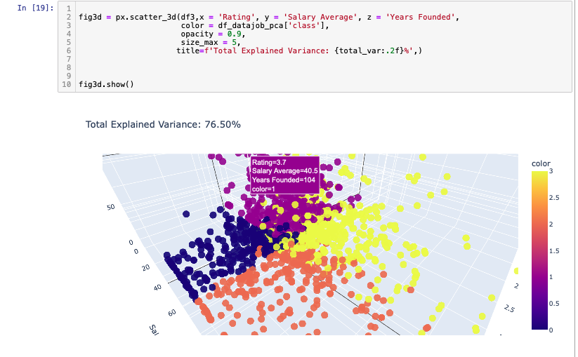
Machine Learning
PCA K-means
3D graph shows better relationship between cluster and features

Slide 29
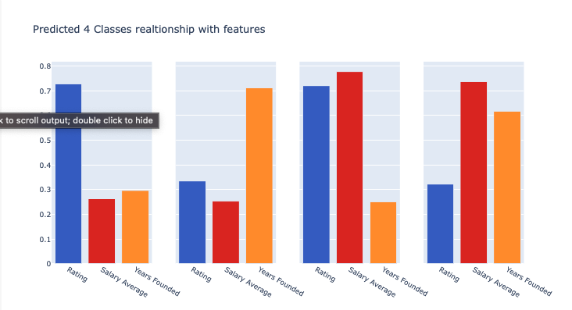
Machine Learning
PCA K-means
Conclusion:
In general,two classes company pays higher.
One is start ups and the second one is
Higher rating company would not guarantee a higher pay
The results are inconsistent
salary distribution varies

Slide 30
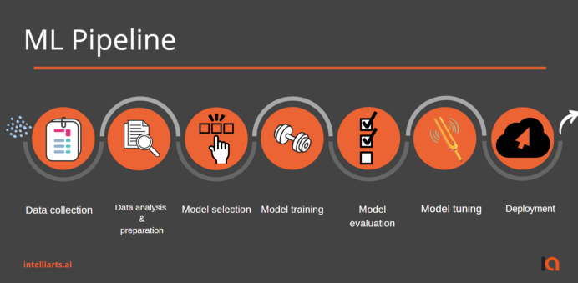
Machine Learning -2
Building the web app
Job Application probability Prediction

Slide 31
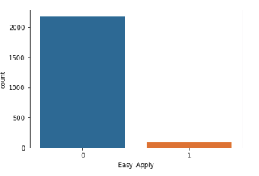
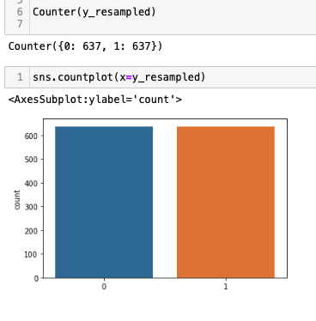
Machine Learning
Data Preprocessing
Job Application probability Prediction
Imbalanced data
Features are : Size,Type_of_ownership , Sector, Revenue,Rating
Target :Easy_Apply
There was an imbalance on the Easy_Apply column.This bias in the training dataset can influence machine learning algorithms. so there was an Oversampling performed.
Oversampling

Slide 32
Machine Learning
Model Selection
Job Application probability Prediction
Model selection and results
Logistic regression model accuracy: 0.772
Neural Network Model
loss: 0.9332 - accuracy: 0.8767 Higher loss
RandomForest Learning
accuracy: 0.95 Highest accuracy
Decision Tree
0.94

Slide 33
Machine Learning
Using Decision Tree
Job Application probability Prediction
The trained model with the highest accuracy score is Random forest Learning, however Decision Tree will be our final choice. Because a decision tree combines some decisions, whereas a random forest combines several decision trees. The random forest model needs rigorous training, it is a longer process, yet slow. Whereas, a decision tree is fast and operates easily on large data sets.

Slide 34
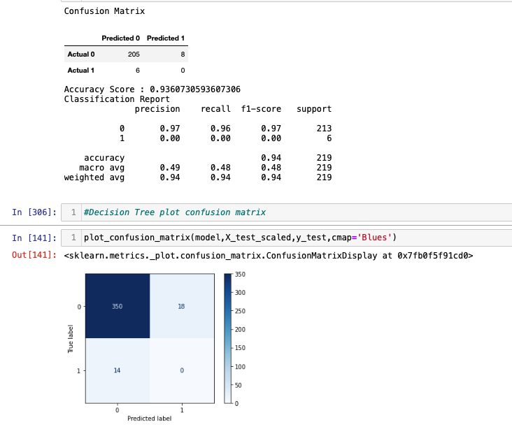
Decision Tree
Confusion Matrix

Slide 35


How to deploy ML using Flask
Preparing for Machine Learning
Web Page
2. Send query to Flask
4. Send the predicted label to the webpage
Flask Server
ML Prep starts by ASKING:
What are we predicting?
What will be our predictor?
What are our features?
3. Send request to predict based on TEXT INPUT
4. Get Predictions
Decision Tree Model
ML pipeline

Slide 36
Steps to build an ML web app
Train our model
create web app using Flask
commit the code in Github
link the Github to Heroku
Deploy the model
Web app is ready

Slide 37
Choropleth Map - Interactive
HTML APP etc.
A colorful interactive map for Data Analyst Jobs; Salary Averages by State.

Slide 38
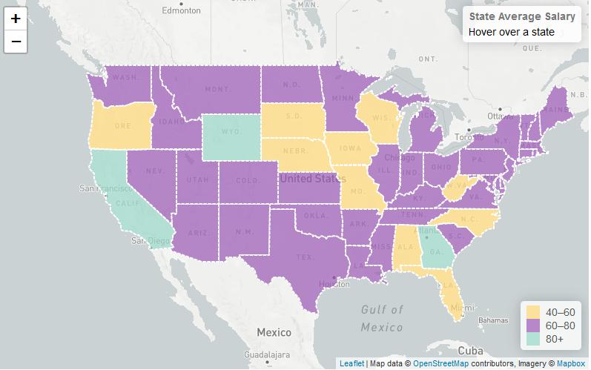
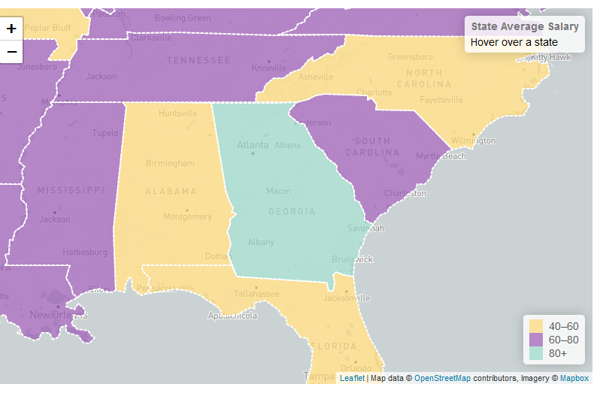
HTML APP etc.
This visualization uses the Average Salary for each state and categorizes the levels low, med, high. See legend in the lower corner.
2 csv files were combined into a dictionary with state boundary geojson data.
Leaflet/Mapbox Interactive US Map

Slide 39
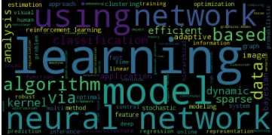
“Word Cloud - most frequent topics at the most recent ML Conference

Slide 40
THE END

Slide 41
2. Examples
By the end of this section, your audience should be able to visualize:
What What is the pain you cure with your solution?
Who Show them a specific person who would benefit from your solution.

Slide 42
4. Closing
Build confidence around your product or idea by including at least one of the these slides:
Milestones What has been accomplished and what might be left to tackle?
Testimonials Who supports your idea (or doesn’t)?
What’s next? How can the audience get involved or find out more?

Slide 44
XTRA stuff if needed below here

Slide 45
Deeper Dive into the Data
Add examples here
Deep Dive into Graphics:
Preparing the File Structure & Components for an App?
Merged/Joined columns to combine lat/long to have a csv for the map we will create using leaflet.Push to Github - Part 1
Built the index.html, CSS file and its contains, logic.js file and its contents.
Connected with Mapbox Styles API
Add the config.js File
Click here for the Code

Slide 46
3. Examples
People need to understand how rare or frequent your examples are.
Pick 1 or 2 statistics and make them as concrete as possible. Stats are generally not sticky, but here are a few tactics:
Relate Deliver data within the context of a story you’ve already told
Compare Make big numbers digestible by putting them in the context of something familiar

